Slide 1
Quadrilaterals
Geometry
Chapter 8
Notes:
Geometry 8

Slide 2
This Slideshow was developed to accompany the textbook
Larson Geometry
By Larson, R., Boswell, L., Kanold, T. D., & Stiff, L.
2011 Holt McDougal
Some examples and diagrams are taken from the textbook.
Slides created by
Richard Wright, Andrews Academy
rwright@andrews.edu

Slide 3
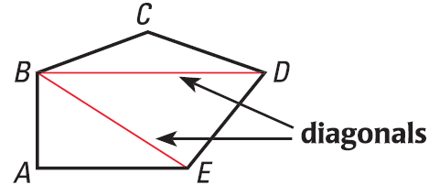
8.1 Find Angle Measures in Polygons
Polygon
Closed figure made of straight segments
Diagonal
Segment that joins nonconsecutive vertices
Notes:
Notice that the pentagon is made into 3 triangles.

Slide 4
8.1 Find Angle Measures in Polygons
All polygons can be separated into triangles
The sum of the angles of a triangle is 180°
For the pentagon, multiply that by 3
Polygon Interior Angles Theorem
Sum of the measures of the interior angles of a n-gon is $(n−2)180°$
$$S=\left(n−2\right)⋅180°$$
Sum of the measures of the interior angles of a quadrilateral is 360°

Slide 5
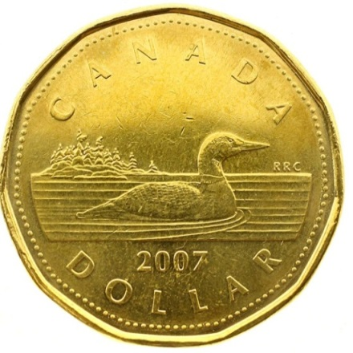
8.1 Find Angle Measures in Polygons
The coin is a regular 11-gon. Find the sum of the measures of the interior angles.
The sum of the measures of the interior angles of a convex polygon is 1440°. Classify the polygon by the number of sides.
Notes:
S = (n-2)180°
S = (11-2)180° = 1620
1440° = (n-2)180°
8 = n-2
n = 10

Slide 6
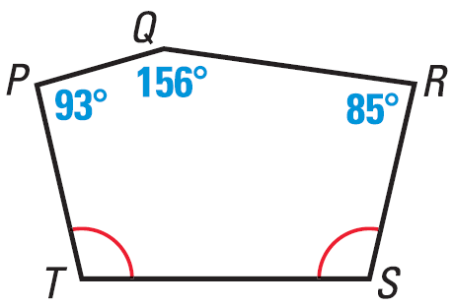
8.1 Find Angle Measures in Polygons
Find m$∠$T
Notes:
S = (n-2)180°
S = (5-2)180° = 540°
93° + 156° + 85° + x + x = 540°
334 + 2x = 540
2x = 206
x = 103

Slide 7
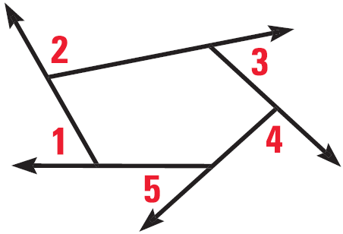
8.1 Find Angle Measures in Polygons
Polygon Exterior Angles Theorem
Sum of the measures of the exterior angles of a convex polygon 360°
What is the measure of an exterior angle of a regular pentagon?
What is the measure of an interior angle of a regular pentagon?
510 #2-34 even, 40-46 even = 21
Notes:
$$\frac{360}{5}=72°$$
$$180=x+72$$
$$x=108$$
Or
$$S=\left(5−2\right)⋅180$$
$$S=540$$
$$int angle=\frac{540}{5}=108$$

Slide 8
Answers and Quiz
8.1 Answers
8.1 Homework Quiz

Slide 9
8.2 Use Properties of Parallelograms
On scrap paper draw two sets of parallel lines that intersect each other.
Measure opposite sides. How are opposite sides related?
Measure opposite angles. How are opposite angles related?

Slide 10
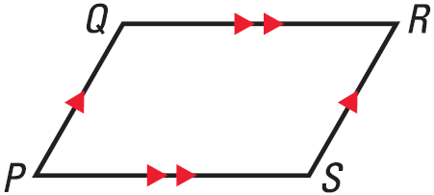
8.2 Use Properties of Parallelograms
Definition of parallelogram
Quadrilateral with opposite sides parallel
Opposite sides of parallelogram are congruent
Opposite angles of a parallelogram are congruent
Notes:
Theorems were demonstrated in the focus

Slide 11
8.2 Use Properties of Parallelograms
Remember from parallel lines (chapter 3) that consecutive interior angles are supplementary
Draw diagonals on your parallelogram
Measure each part of the diagonals to see if they bisect each other.
Consecutive angles in a parallelogram are supplementary
Diagonals of a parallelogram bisect each other

Slide 12
8.2 Use Properties of Parallelograms
Example:
Find x, y, and z if the figure is a parallelogram.
x = 70
y = 42
z = 20
y
20°
z°
42
x°

Slide 13
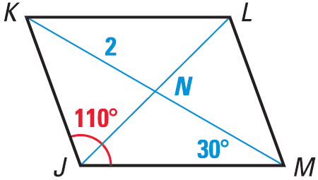
8.2 Use Properties of Parallelograms
Find NM
Find m$∠$JML
Find m$∠$KML
518 #4-28 even, 32, 36, 43, 44, 46-56 even = 23
Extra Credit 521 #2, 4 = +2

Slide 14
Answers and Quiz
8.2 Answers
8.2 Homework Quiz

Slide 15
8.3 Show that a Quadrilateral is a Parallelogram
Review
What are the properties of parallelograms?
Opposite sides parallel
Opposite sides are congruent
Opposite angles are congruent
Diagonals bisect each other

Slide 16
8.3 Show that a Quadrilateral is a Parallelogram
If we can show any of these things in a quadrilateral, then it is a parallelogram.
If both pairs of opposite sides of a quad are parallel, then it is a parallelogram (definition of parallelogram)
If both pairs of opposite sides of a quad are congruent, then it is a parallelogram.
If both pairs of opposite angles of a quad are congruent, then it is a parallelogram.
If the diagonals of a quad bisect each other, then it is a parallelogram.
If one pair of opposite sides of a quad is both parallel and congruent, then it is a parallelogram.

Slide 17
8.3 Show that a Quadrilateral is a Parallelogram
Examples: Is it a parallelogram?
6 cm
6 cm
Notes:
First: yes
Second: No, congruent is not same as parallel

Slide 18
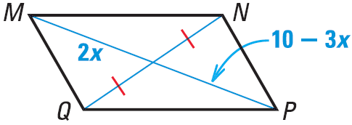
8.3 Show that a Quadrilateral is a Parallelogram
In quadrilateral WXYZ, m$∠$W = 42°, m$∠$X = 138°, m$∠$Y = 42°. Find m$∠$Z. Is WXYZ a parallelogram?
Find x so that MNPQ is a parallelogram.
Notes:
Sum of angles = 360
$$42°+138°+42°+m∠Z=360°$$
$$m∠Z=138°$$
Diagonals bisect each other
$$2x=10−3x$$
$$5x=10$$
$$x=2$$

Slide 19
8.3 Show that a Quadrilateral is a Parallelogram
526 #4-30 even, 34, 36, 39, 43-47 all = 22

Slide 20
Answers and Quiz
8.3 Answers
8.3 Homework Quiz

Slide 21
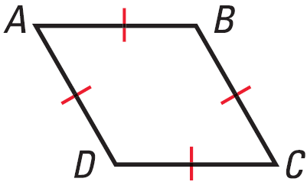
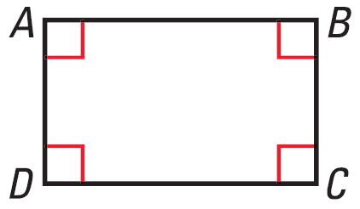
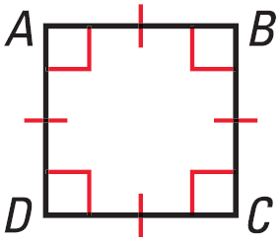
8.4 Properties of Rhombuses, Rectangles, and Squares
All of these are parallelograms
Rhombus
Four =̃ sides
Rectangle
Four right $∠$s
Square
Rhombus and Rectangle
Four =̃ sides
Four right $∠$s

Slide 22
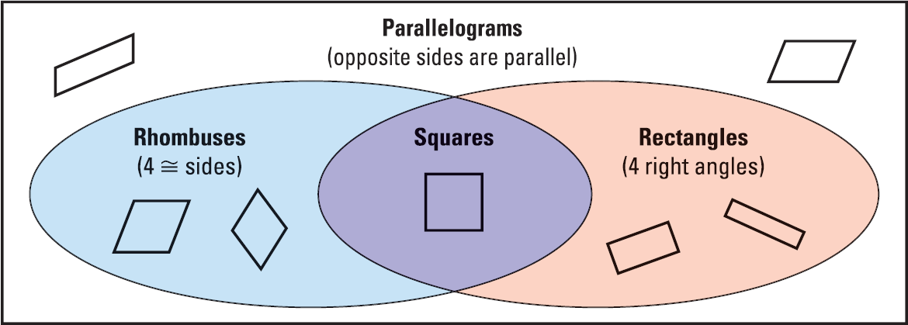
8.4 Properties of Rhombuses, Rectangles, and Squares

Slide 23
8.4 Properties of Rhombuses, Rectangles, and Squares
For any rectangle EFGH, is it always or sometimes true that $\overline{FG}≅\overline{GH}$?
A quadrilateral has four congruent sides and angles. Classify the figure.
Notes:
Sometimes, $\overline{FG}$ and $\overline{GH}$ are consecutive sides, not opposite
Square; each angle is 360/4 = 90 and all sides =̃

Slide 24
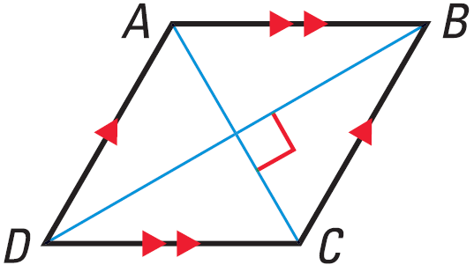
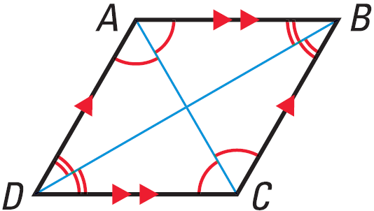
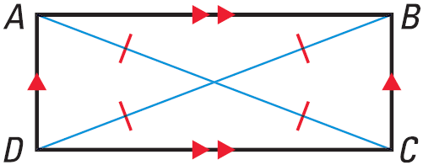
8.4 Properties of Rhombuses, Rectangles, and Squares
Diagonals
Rhombus: diagonals are perpendicular
Rhombus: diagonals bisect opposite angles
Rectangle: diagonals are congruent

Slide 25
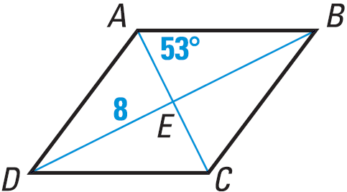
8.4 Properties of Rhombuses, Rectangles, and Squares
ABCD is a rhombus
Find m$∠$AED
Find DB
Find AC
Notes:
Diagonals are perpendicular: m$∠$AED = 90°
Diagonals bisect each other: DE = EB = 8
DE + EB = DB = 16
Right triangle AEB is formed with EB = 8
Use $\tan{53°}=\frac{8}{AE}$
$AE\tan{53°}=8$
$AE=\frac{8}{\tan{53°}}=6.0$

Slide 26
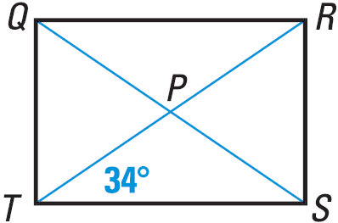
8.4 Properties of Rhombuses, Rectangles, and Squares
QRST is a rectangle with QS = 10
Find m$∠$QPR
Find RP
Find RS
537 #2-52 even, 60-70 even = 32
Extra Credit 540 #2, 5 = +2
Notes:
$$m∠QPR=m∠SPT$$
$$m∠PTS=m∠TSP=34°$$
$$m∠QPR=m∠SPT=180°−34°−34°=112°$$
Diangonals are congruent and bisect each other
$$RP=\frac{1}{2}RT=\frac{1}{2}QS=\frac{1}{2}\left(10\right)=5$$
RT = 10
m$∠$RTS = 34°
$$\sin{34°}=\frac{RS}{10}$$
$$RS=10⋅\sin{34°}=5.6$$

Slide 27
Answers and Quiz
8.4 Answers
8.4 Homework Quiz

Slide 28
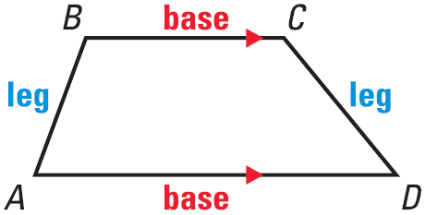
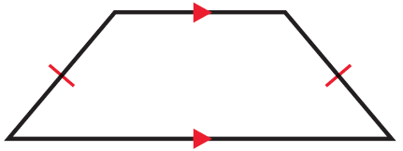
8.5 Use Properties of Trapezoids and Kites
Trapezoid
Quadrilateral with exactly one pair of parallel sides
If the legs are =̃, then the trap is isosceles

Slide 29
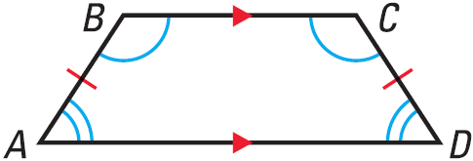
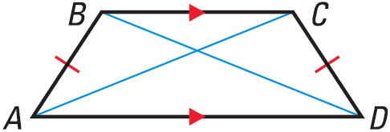
8.5 Use Properties of Trapezoids and Kites
If isosceles trapezoid, then each pair of base angles is =̃.
If isosceles trapezoid, then diagonals are =̃.
The converses are also true

Slide 30
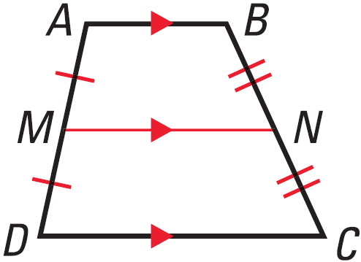
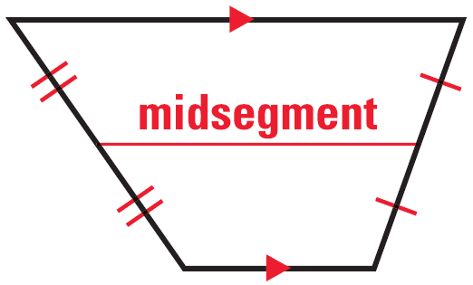
8.5 Use Properties of Trapezoids and Kites
Midsegment of a Trapezoid
Segment connecting the midpoints of each leg
Midsegment Theorem for Trapezoids
The midsegment of a trapezoid is parallel to the bases and its length is the average of the lengths of the bases.
$$MN=\frac{1}{2}\left(b_{1}+b_{2}\right)$$

Slide 31
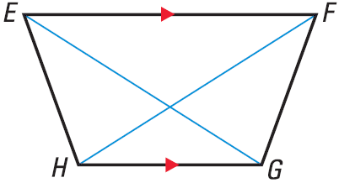
8.5 Use Properties of Trapezoids and Kites
If EG = FH, is trapezoid EFGH isosceles?
If m$∠$HEF = 70° and m$∠$FGH = 110°, is trapezoid EFGH isosceles?
Notes:
Yes, If the diagonals are =̃, then the trapezoid is isosceles
$$m∠HEF+m∠EHG=180°$$
$$70°+m∠EHG=180°$$
$$m∠EHG=110°=m∠FGH$$
Since the base angles are =̃, the trapezoid is isosceles

Slide 32
8.5 Use Properties of Trapezoids and Kites
In trapezoid JKLM, $∠$J and $∠$M are right angles, and JK = 9 cm. The length of the midsegment $\overline{NP}$ of trapezoid JKLM is 12 cm. Find ML.
Notes:
$$midsegment=\frac{1}{2}\left(b_{1}+b_{2}\right)$$
$$12=\frac{1}{2}\left(ML+9\right)$$
$$24=ML+9$$
$$ML=15$$

Slide 33
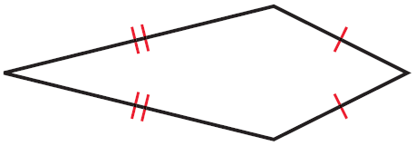
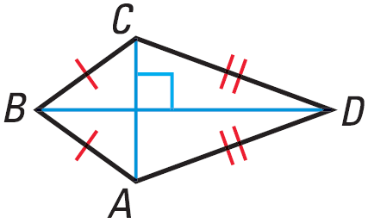
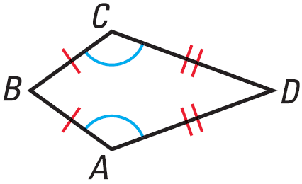
8.5 Use Properties of Trapezoids and Kites
Kites
Quadrilateral with 2 pairs of consecutive congruent sides
If kite, then the diagonals are perpendicular.
If kite, then exactly one pair of opposite angles are congruent.

Slide 34
8.5 Use Properties of Trapezoids and Kites
In a kite, the measures of the angles are 3x°, 75°, 90°, and 120°. Find the value of x.
546 #4-32 even, 38, 44-48 all = 21
Notes:
$$3x°+75°+90°+120°=360°$$
$$3x°+285°=360°$$
$$3x°=75°$$
$$x=25$$

Slide 35
Answers and Quiz
8.5 Answers
8.5 Homework Quiz

Slide 36
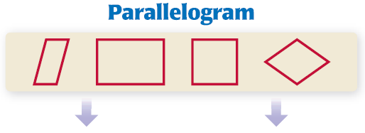
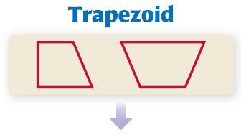
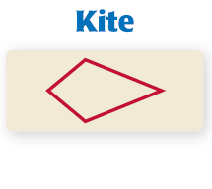
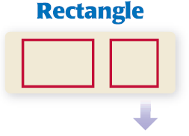
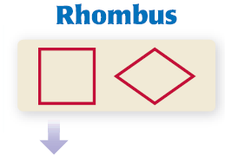
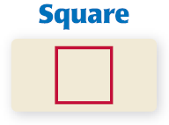
8.6 Identify Special Quadrilaterals

Slide 37
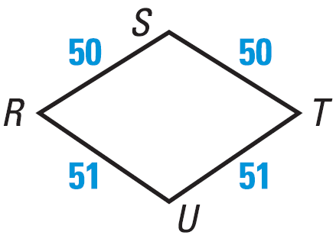
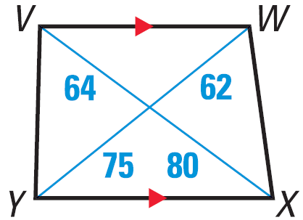
8.6 Identify Special Quadrilaterals
Quadrilateral DEFG has at least one pair of opposite sides congruent. What types of quadrilaterals meet this condition?
Give the most specific name for the quadrilateral.
Notes:
Parallelogram, rectangle, rhombus, square, trapezoid, isosceles trapezoid
Kite (=̃ consecutive sides)
Trapezoid (exactly one pair of parallel sides, diagonals not =̃)

Slide 38
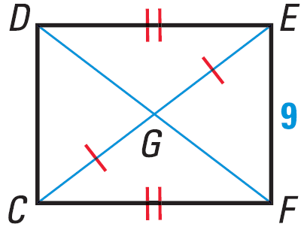
8.6 Identify Special Quadrilaterals
Give the most specific name for the quadrilateral.
A student knows the following information about quadrilateral MNPQ: $\overline{MN}‖\overline{PQ}$, $\overline{MP}≅\overline{NQ}$, and $∠P≅∠Q$. The student concludes that MNPQ is an isosceles trapezoid. Why is this wrong?
554 #3-12 all, 14-30 even, 38, 40, 44-50 even = 25
Extra Credit 557 #2, 4 = +2
Notes:
Quadrilateral (not enough information to be more specific)
Could be a square or a rectangle since you don’t know the relationship between $\overline{MQ}$ and $\overline{NP}$.

Slide 39
Answers and Quiz
8.6 Answers
8.6 Homework Quiz

Slide 40
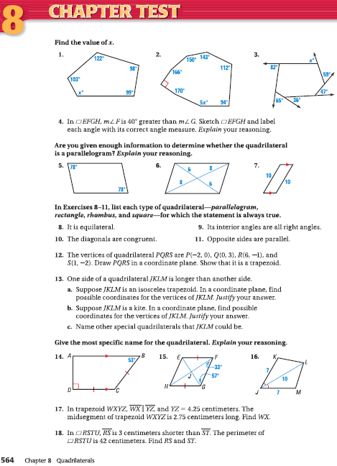
8.Review
564 #1-18 all = 18

